Slide 1
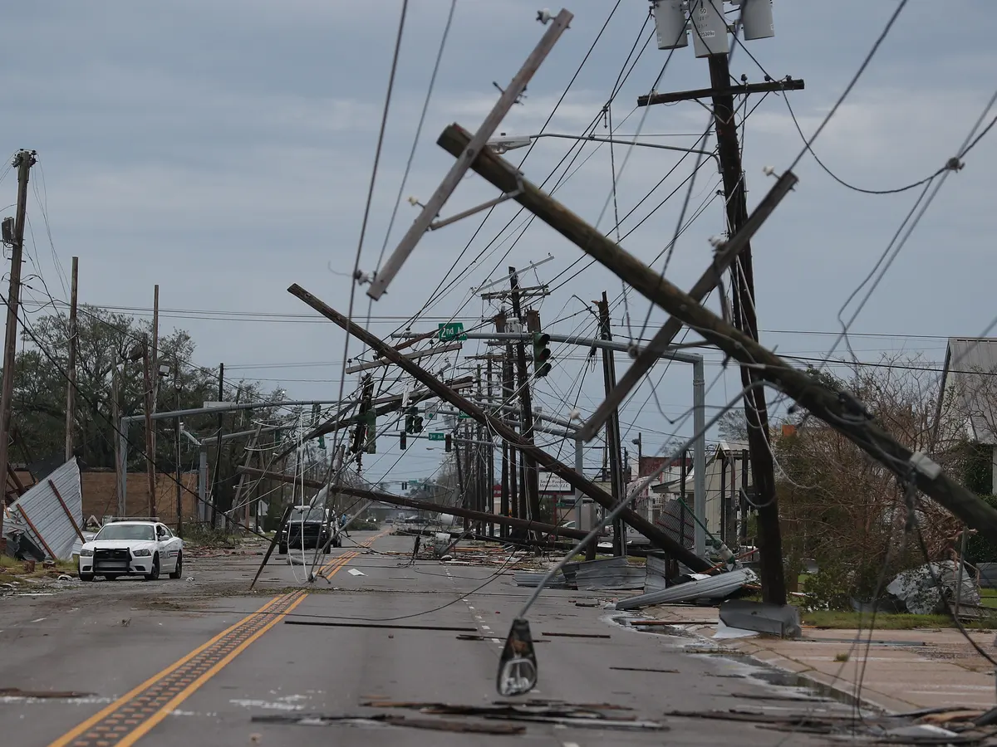
Company Presentation
World’s Very First
Underground Safety Cabinet System
KOREA SAFETY INDUSTRY INC.

Slide 2
Index
01 Company Introduction
About KORSI
Company History
04 Certificates
Patents
Credentials
02 Underground Safety Cabinet
Company Background
Introducing USC
Product Features
05 Media Coverage
On Electrical Safety
On Fire Safety
Frequently Asked Questions
03 Business Areas
Electrical Safety
Fire Safety
06 Contact Information
Electrical Safety
Fire Safety

Slide 3
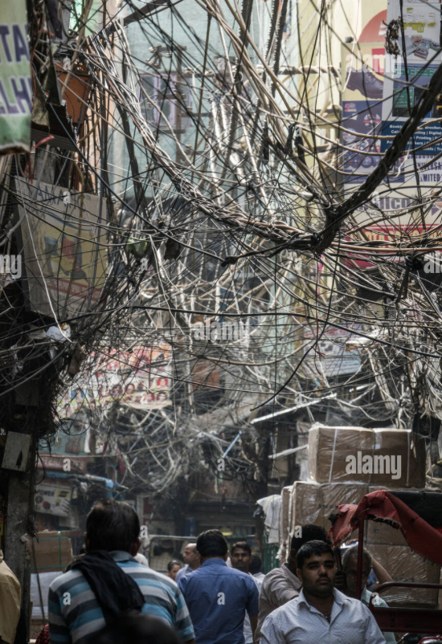
01
Company Introduction About KORSI
As modern society undergoes rapid industrialization, the demand for electrical facilities has surged. This has led to the installation of public electrical equipment, such as transformers, street light distribution boxes, traffic signal distribution boxes, and electric vehicle charging stations, as well as fire fighting boxes.
While these facilities are necessary to provide electricity to cities and towns, they also pose a safety risk to citizens, especially during natural disasters such as typhoons, hurricanes or even sandstorms caused by climate change.
At Korea Safety Industry Inc.(KORSI),
we recognized this problem and developed the world's first Underground Safety Cabinet(USC) and Underground Firefighting Equipment Cabinet(UFEC). Our products can safely bury both electrical equipment and fire fighting equipment underground, enhancing safety and aesthetics in cities.
By continuously improving our patented technologies and integrating them with complementary ones, we aspire to create a positive impact on society and contribute towards a safer future.

Slide 4
01
Company Introduction Company History
June 2016
December 2016
February 2017
March 2017
September 2017
October 2017
October 2017
May 2018
July 2018
May 2019
May 2019
July 2019
November 2020
December 2020
2021~Present
December 2022
Underground Safety Cabinet System registered for world patents – Japan, USA, China, Europe
Approval for Underground Safety Cabinet (Traffic Signal Controller) from the National Police Agency
Establishment of Korean Safety Industry Co., Ltd.
3 years of Pilot Installation and KERI electric technology test/KEPCO standard purchase
specification established/ Full Implementation by Korea Electric Power Corporation
Underground Safety Cabinet System (transformer) adopted as a trusted material item by Korea
Electric Power Corporation
Export of first Underground Safety Cabinet to Ho Chi Minh, Vietnam
Contract for installation of one unit of Underground Safety Cabinets (electric vehicle charger)
in Seoul Jung-gu Da-dong, KEPCO (Seoul Regional Headquarters)
Contract for installation of seven units of Underground Safety Cabinets System (transformer)
in Seoul Jung-gu Namsoyounggil - Seoul City Jung-gu/KEPCO
Installation of 10 Underground Firefighting Equipment Cabinets (UFEC)
(citizen autonomous firefighting cabinets) - Seoul Metropolitan Fire & Disaster Headquarters
(Jongno, Jung-gu, Yongsan, Dongdaemun, Yeongdeungpo)
New S changes its name to Korean Safety System
Contract for installation of five units of Underground Safety Cabinets for transformers
in Jukdo Market, Pohang, Gyeongsangbuk-do - Pohang City/ KEPCO
Underground Firefighting Equipment Cabinet System 2 Patents, 1 Design registered
Awarded the Minister of the Interior and Safety Award (Outstanding Product)
at the 19th Korea Safety Awards for Underground Firefighting Equipment Cabinet System
- National Fire Agency
Selected for “New Firefighting Technology” - National Fire Agency
Supplying Underground Firefighting Equipment Cabinets to Seoul, Incheon, Gyeonggi, Daejeon,
and Busan regions (aroung 400 boxes installed)
Development of new technology products through collaboration with Sawwave Inc.

Slide 5
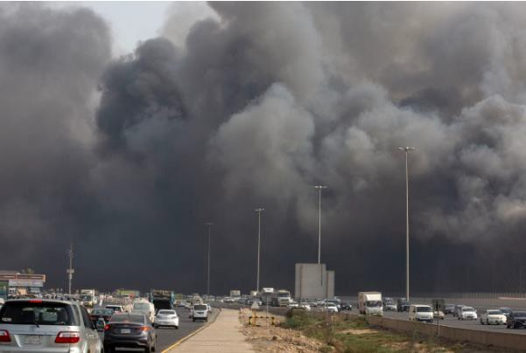
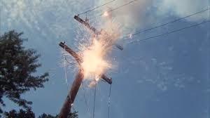
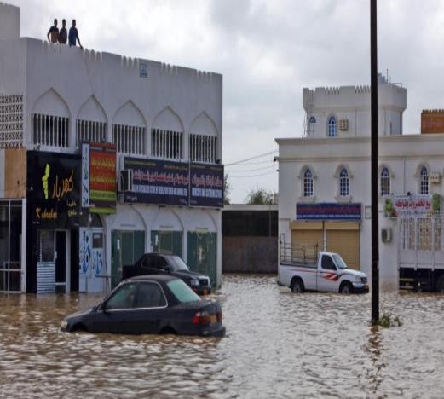
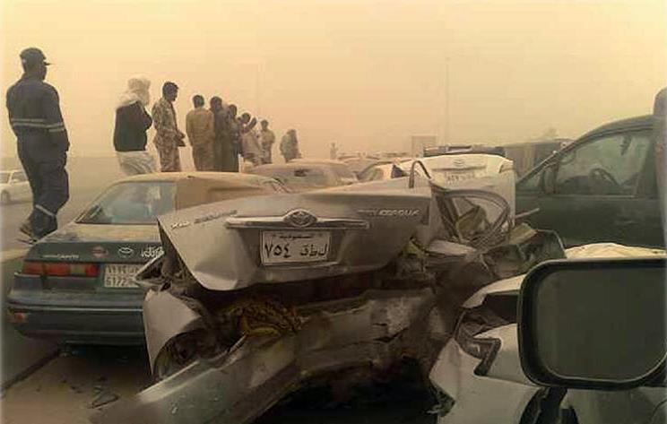
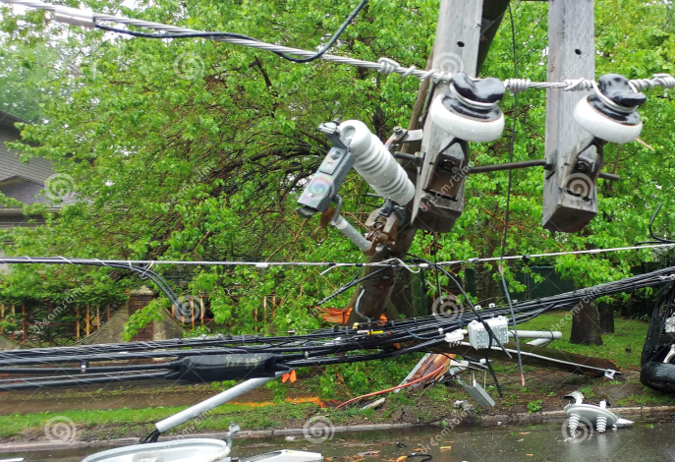
02
Underground Safety Cabinet
Company Background
Have you ever noticed electrical circuits or facilities while walking around your city or town? These facilities named transformers, responsible for distributing power to households and buildings, have become a ubiquitous presence in today's industrialized world.
While safety measures such as the installation of fire fighting boxes aim to protect people, it's essential to consider the potential dangers that these facilities pose to the public during natural disasters or heat waves.
At Korea Safety Industry Inc.(KORSI), we're committed to addressing these safety concerns. We've developed world's very first Underground Safety Cabinet(USC), which securely contains the electrical equipment needed for a city's power supply. Further, based on this technology, we also developed Underground Firefighting Equipment Cabinet(UFEC) to safely store all the firefighting equipment in it. Our products provide an added layer of protection and minimizes the risk of accidents and explosions.
Moving forward, we're dedicated to further enhancing our product, exploring collaborative opportunities with other companies, and working towards our goal of achieving eternal safety.

Slide 6
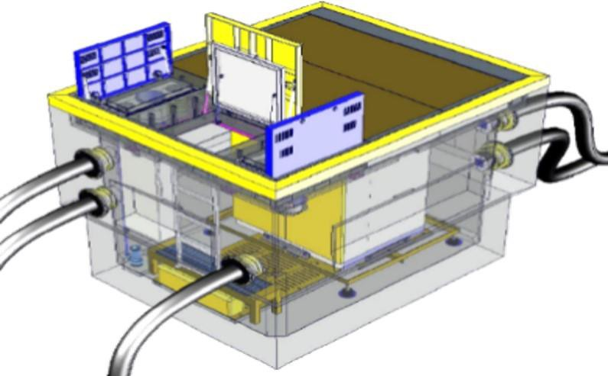
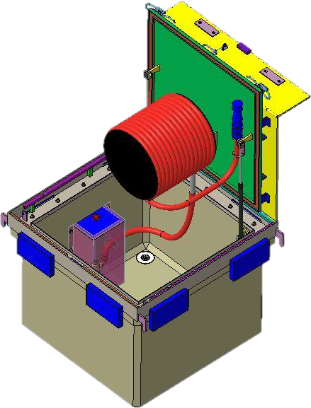
02
Underground Safety Cabinet (USC)
Introducing USC
USC for Electrical Devices
UFEC
(Underground Firefighting Equipment Cabinet)
USC is a multipurpose, multi-functional, Underground Safety Cabinet System. It’s sole purpose is to place ground-exposed electric public devices underground for safe operation and management.
Our product is designed and composed of seven features. Key features of our product includes that it is waterproof and self ventilating.
Civil engineering, architecture, electricity, machinery, electronic communication, and IT control are integrated into our USC system making this a whole new technology. Based on USC technology, UFEC was developed for firefighting which will be introduced later in this presentation. We hope this innovative products serve a great purpose to our society, mainly prioritizing on the safety of the public ; starting from Korea, now worldwide.

Slide 7
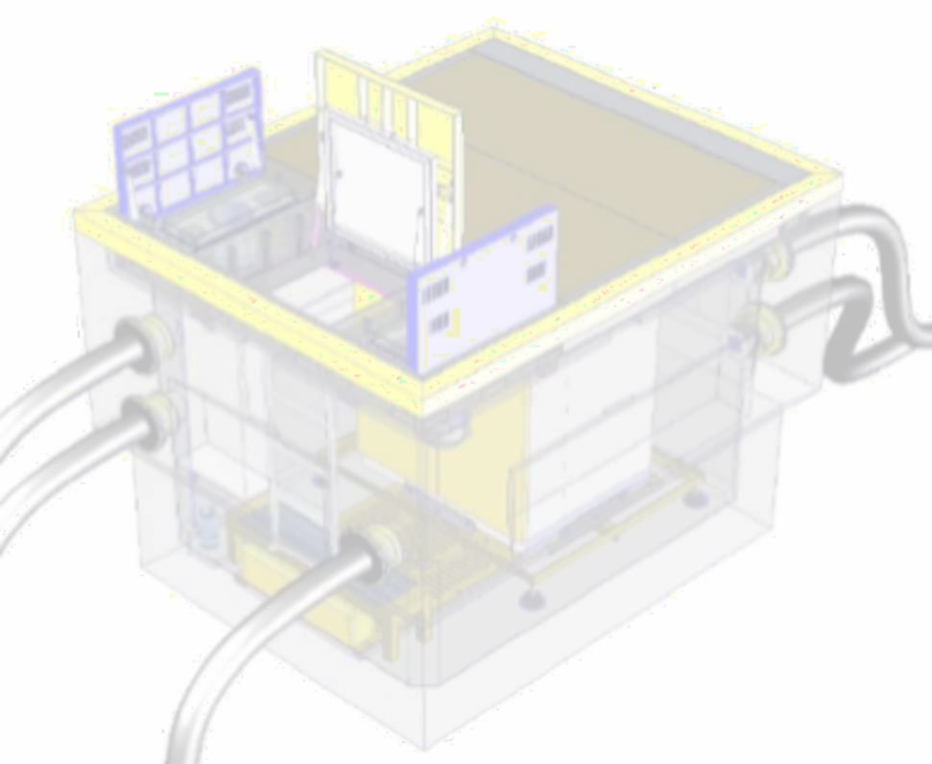
02
Underground Safety Cabinet
Product Features
The Underground Safety Cabinet System has seven features that ensure an optimal environment for transformer operation:
Water-proof Feature (IPX8): This feature seals off water penetration through a combination of methods, including shield method, sphere waterproofing, outer wall waterproofing, insertion of sleeves, and high- pressure steaming. It provides a waterproof rating of IPX 8.
Heat Dissipating Feature: This feature dissipates heat rising from transformers/switches using a new waterproof HVAC and heat dissipating panel to disperse heat externally.
Moisture-proof Feature: This feature prevents moisture and dew condensation by matching internal and external temperature through natural ventilation and heat dissipation using a new waterproof HVAC and heat dissipating panel.
HVAC Feature: This feature employs a waterproof mechanical Heating,Ventilation, and Air conditioning (HVAC) system with natural air circulation to maintain internal space.
Decompression Feature: This feature forces downward pressure in the event of a transformer explosion to prevent damage to the above surface level.
System Control Feature: This feature enables both internal and external control of the system via wired or wireless communications.
Mechanical operation Feature: The system's outer cover, inner cover (water-tight), waterproofing, and HVAC can be operated manually without power.

Slide 8
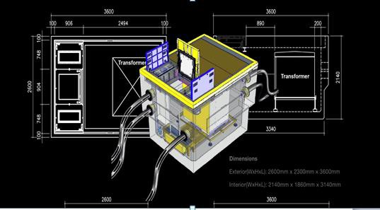
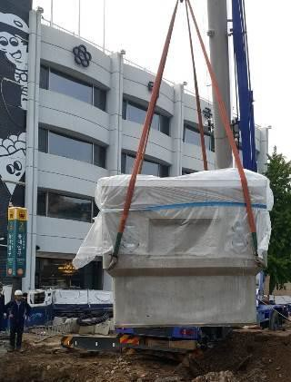
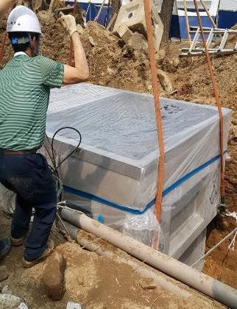
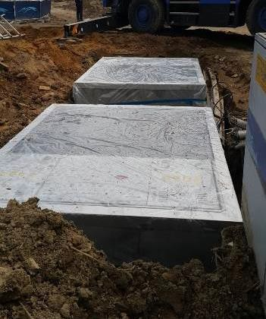
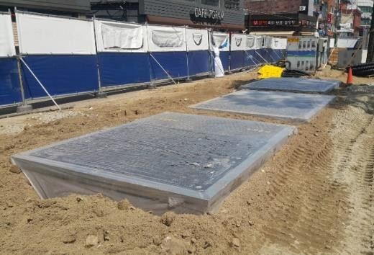
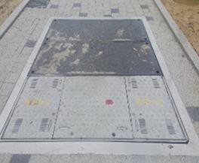
03
Business Areas
Electrical Safety Products
Four Types of USC products aiming for :
preventing negligent accidents, preventing natural disasters
protecting pedestrians, preventing head-on collisions
enhancing aesthetics in cities
1. USC for High Voltage Transformer
Model : S-1 (Smart-1)
Exterior
2,600(W) x 3,600(L) x 2,300(H)
Interior
2,140(W) x 3,140(L) x 1,810(H)
•
•
•
•
Installation Process
→
→
→
→

Slide 9
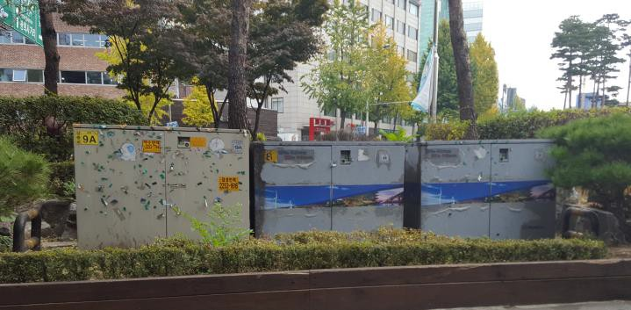
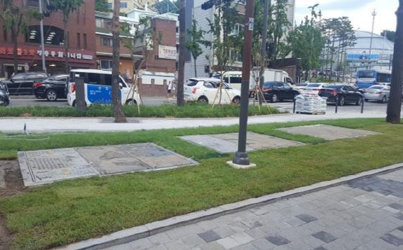
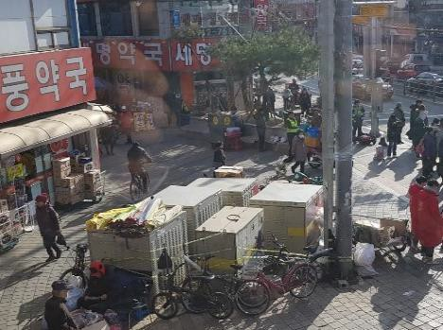
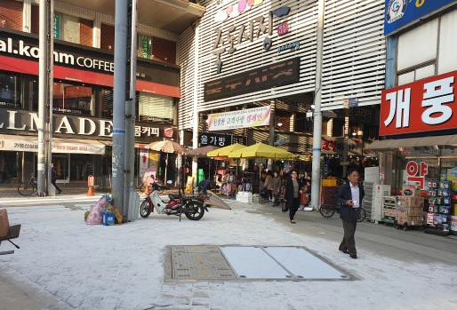
Installation Examples of USC for Transformers
: Before & After
Installed 7 units of USC
for transformers in Seoul (2018)
Installed 5 units of USC
for transformers in Pohang (2019)

Slide 10
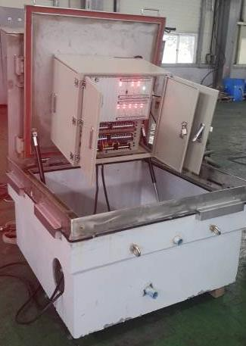
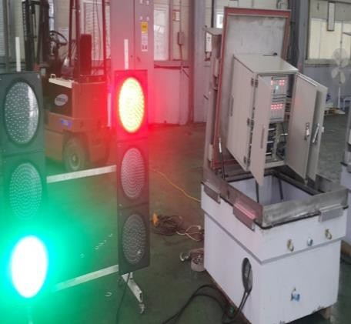
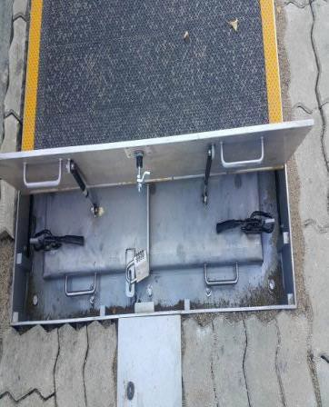
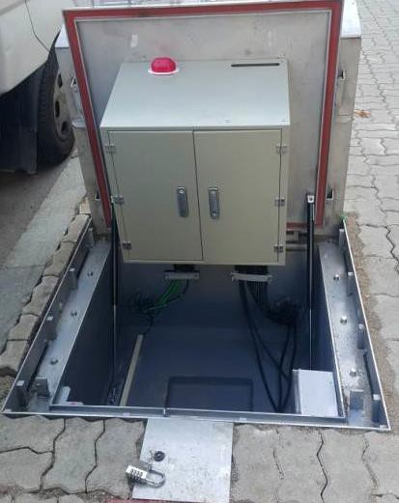
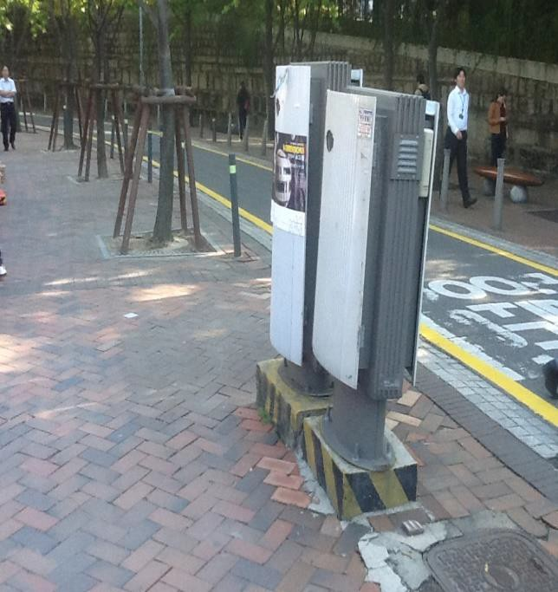
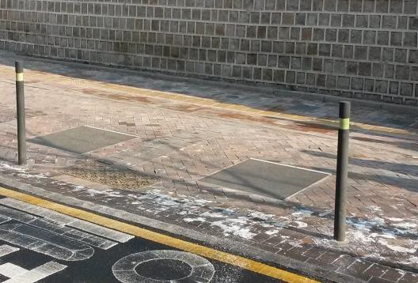
03
Business Areas
Electrical Safety Products – cont’d
2. USC for Traffic Signal Box Model : M-1 (MOLE)
Exterior
1100(W) x 1100(L) x 630(H)
Interior
880(W) x 880(L) x 430(H)
Testing of traffic light controller
Top cover opened
Inner cover opened
Installation Example- Seoul
Before
After (2010)

Slide 11
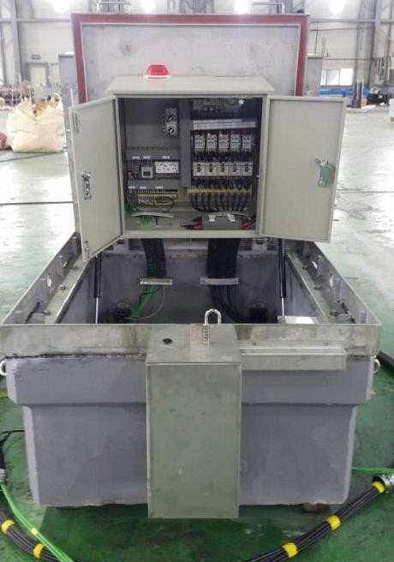
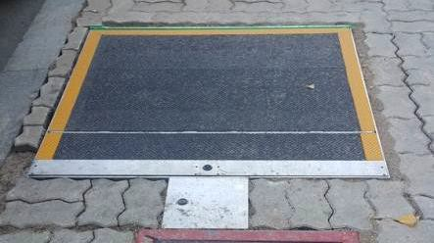
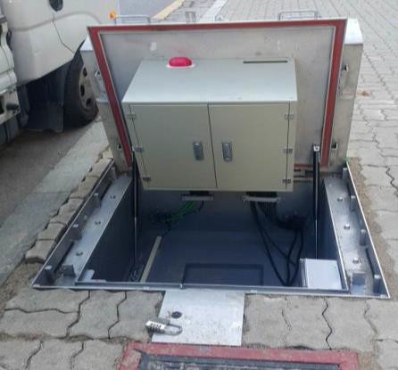
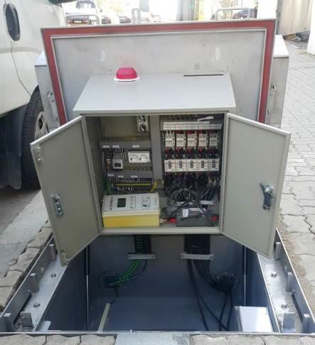
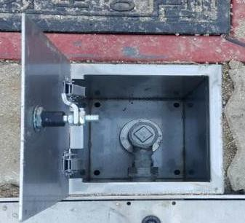
03
Business Areas
Electrical Safety Products – cont’d
3. USC for Street Light Distribution Box
Model : F-1 (FOCUS)
Exterior
1100(W) x 1100(L) x 630(H)
Interior
880(W) x 880(L) x 430(H)
installed in streets
Top cover opened
Inner cover opened
Opening/Closing
Includes Waterproof HVAC

Slide 12
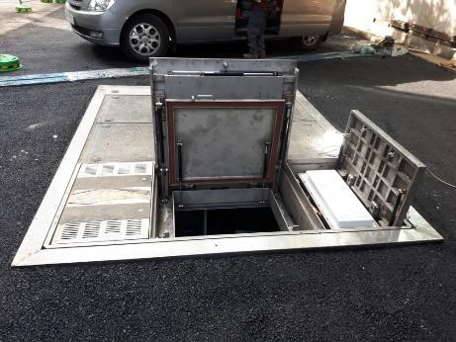
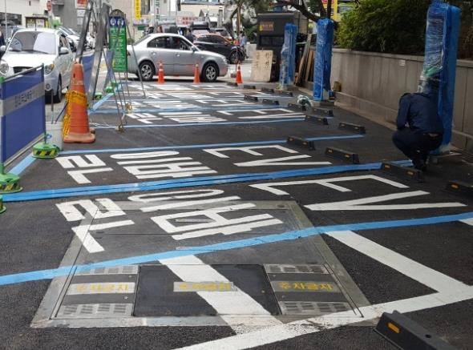
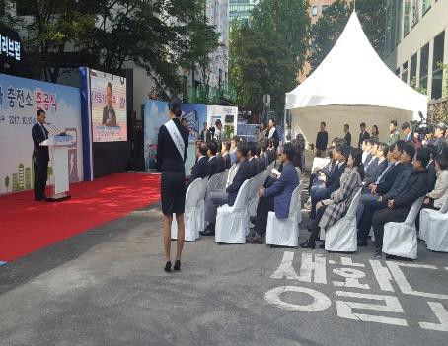
03
Business Areas
Electrical Safety Products – cont’d
4. USC for Electric Vehicle Inverter
Model : C-1 (CAR)
Exterior
2800(W) x 2300(L) x 2100(H)
Interior
2300(W) x 1800(L) x 16500(H)
World’s first street parking lot
EV charging Station
by City of Seoul/ KEPCO
Completion Ceremony
for the World’s first streetparking lot
EV charging Station, Seoul (2017)

Slide 13
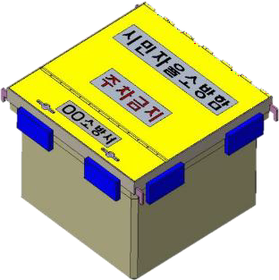
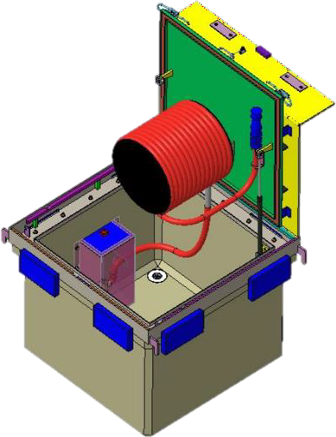
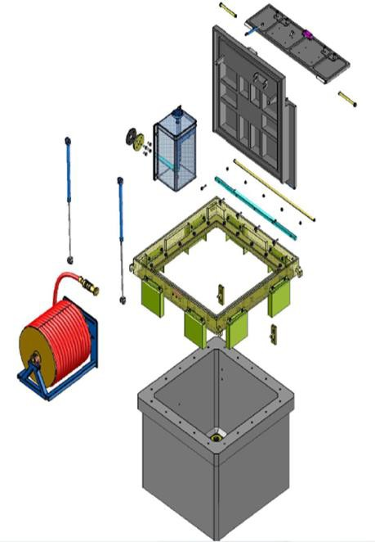
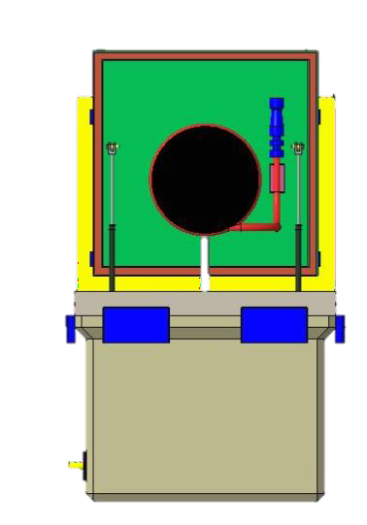
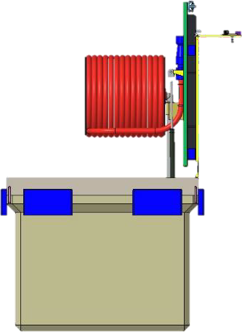
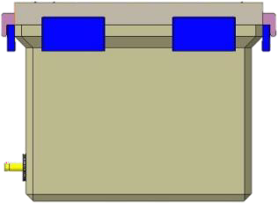
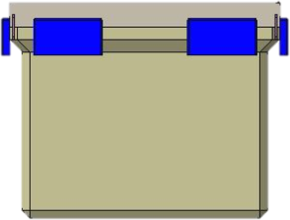
03
Business Areas
Fire Safety Product
Aiming to
prevent damages from extreme weather, theft, collisions
install on placees including where firetrucks can hardly reach
enable citizens voluntarily and immediately initiate extinguishing of the fire
protect historical landmarks and treasure preservation areas
protect vulnerable traditional markets/heavily dense dwellings
Underground Firefighting Equipment Cabinet (UFEC)
Exterior : 1100(W) x 1100(L) x 900(H)
Interior : 900(W) x 900(L) x 700(H)
Open-Front
View
Open-Right
View
Close-Front
View
Close-Right
View

Slide 14
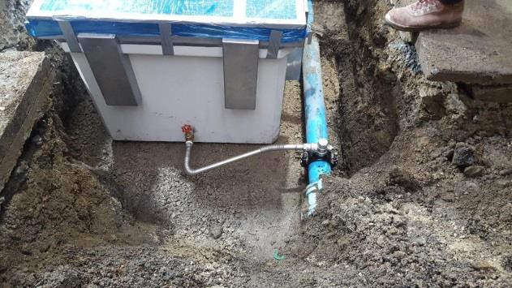
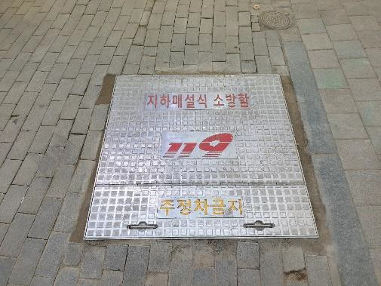
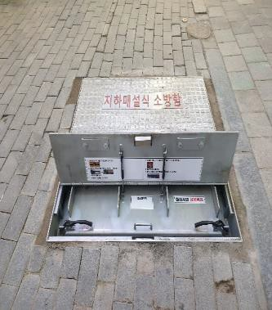
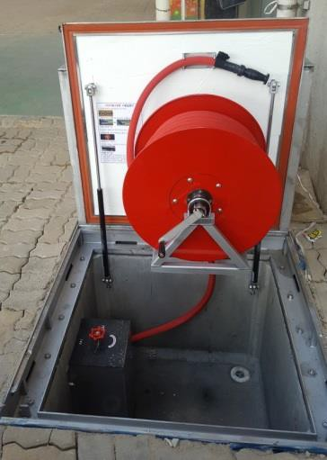
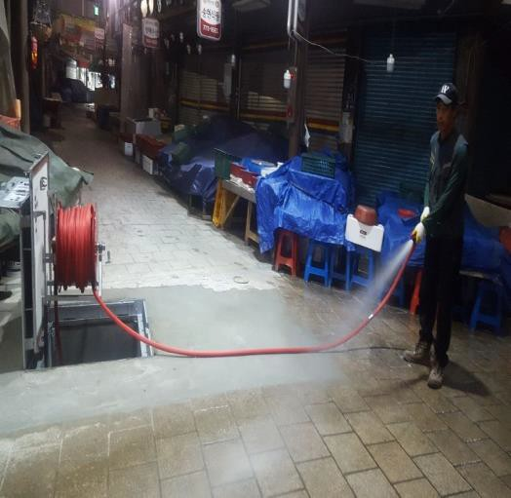
03
Business Areas
Fire Safety Products – cont’d
connected to water pipe 1M below ground level during installation
non-emergency state
In Case of FIRE
open the
top cover
open the
inner cover
extinguish fire with UFEC

Slide 15
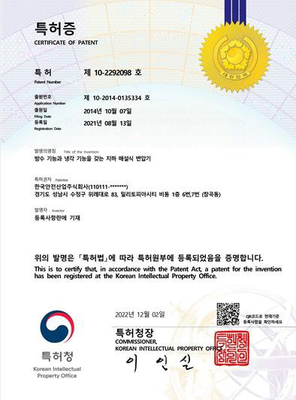
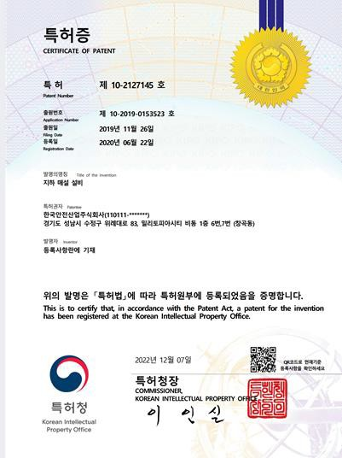
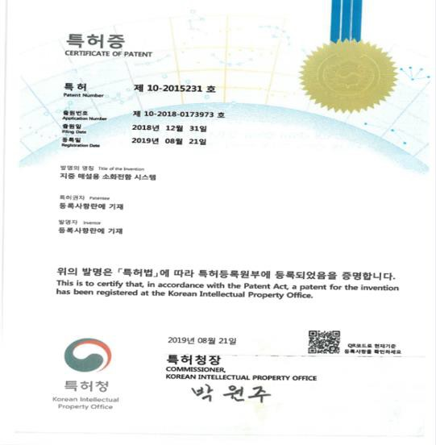
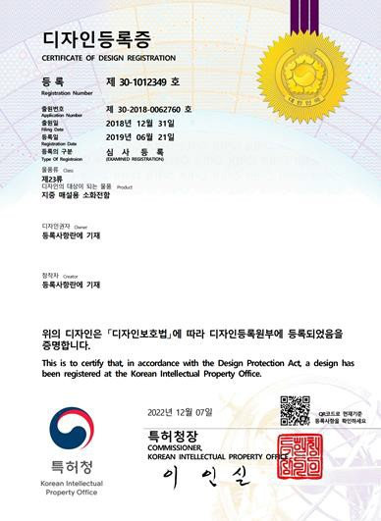
04
Certificates
Patents

Slide 16
04
Certificates
Credentials
ISO(Internatioanl Organization for Standardization) Certificates (2023 present)
USC designated as a “New Industry Classification” by Public Procurement Service (2012)
Approval for USC for Traffic Signal Distribution Box from the National Police Agency (2016)

Slide 17
04
Certificates
Credentials – cont’d
등록 기관 |  | 산업 분류 명 | 분류 번호 | 영 문 명 | 등 록 일
조 달 청 |  | 지하매설 식기기함 | 24112495 | UNDERGROUND EQUIPMENT CABINETS | 2012년08월10일
USC designated as a “New Industry Classification” by Public Procurement Service
USC selected for “New Firefighting Technology” – National Fire Agency
USC awarded the Minister of the Interior and Safety Award (Outstanding Product-Grand Award)

Slide 18
05
Media Coverage
On Electrical Safety
News on USC on via various kinds of media,
including major broadcasting systems such as MBC and KBS,
local newspapers, lewsletters, and many other financial newspapers.

Slide 19
06
Media Coverage
On Fire Safety
Promotional pieces of writing on UFEC
– uploaded on official website of Seoul Metropolitan Government
The Minister of Public Administration and Security on the UFEC booth in Fire Safety Expo (2019)
Demonstration of UFEC
News on UFEC on various kinds of newspapers

Slide 20
06
Media Coverage
On Fire Safety
Reported Cases of Early Fire Suppression Using UFEC

Slide 21
06
Media Coverage
Frequently Asked Questions (FAQ)
What are the advantages of Underground Safety Cabinet (USC) and Underground Firefighting Equipment Cabinet (UFEC)?
For USC, climate control features allow transformers to properly function even under extreme weather conditions.
For UFEC, it can be installed in sites without any limitations, especially in heavily densed dwellings and outdoor traditional markets.
How long do USC and UFEC get to be installed?
It usually takes a day.
Are USC and UFEC safe in floods, heavy rain, or storms?
Completely waterproof, thus, immune to water submersion.
Do UFC and UFEC need electric power to get opened and closed?
Mechanically designed where no electrical power is needed to open and close the cabinet system.
What happens if buried transformer explode?
Decompression technology used where in case of transformer explosion; pressure will be transferred downward causing no damages to surface level.
What are the other advantages of installing USC and UFEC?
No protrusion on the street level eliminating power outage from head-on collisions.
Minimum maintenance needed.
So…..
Trust KORSI and stay calm & SAFE!!

Slide 22
contact us
KOREA SAFETY INDUSTRY INC. (KORSI)
Contact Us
Korea Safety Industry Inc.
Suite #6 and #7, 1st FL, 83 Wirye-Daero,
Sujeong-gu, Songnam-si,
Gyeonggi-do, Korea
Phone
Fax
Email
Website
| +82-31-759-1233
| +82-31-733-1190
| yang5315@naver.com
| www.korsi.co.kr

